Slide 1
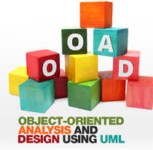




Course Name
object oriented analysis and design
CSC 2210
(Undergraduate)
Software engineering (Undergraduate)
Chapter 1
why do we model things?
M. Mahmudul hasan
Assistant Professor, CS, AIUB
Web: http://cs.aiub.edu/profile/m.hasan
WordPress: https://wordpress.com/view/mhasansuman.wordpress.com

Slide 2
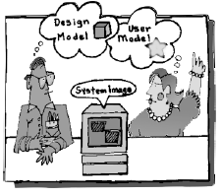
Why we model?
Chapter 1: Why do we Model things
M. Mahmudul Hasan
S.2
MMH
A model is a simplification of reality
A model provides the blueprints of a system.

Slide 3
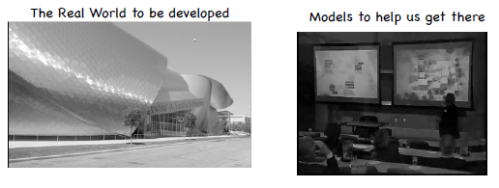
Why we model?
Chapter 1: Why do we Model things
M. Mahmudul Hasan
S.3
MMH
The larger and more complex the system, the more important modelling becomes, for one very simple reason:
We build models of complex systems because we cannot fully mean of such a system in its entirety.
There are limits to the human ability to understand complexity. Through modelling we narrow the problem we are studying by focusing on only one aspect at a time.

Slide 4
Why we model?
Chapter 1: Why do we Model things
M. Mahmudul Hasan
S.4
MMH
Modeling is the designing of software applications before coding.
Modeling is an Essential Part of large software projects, and helpful to medium and even small projects as well.
Modelling is a proven and well-accepted engineering technique.
Unsuccessful software projects fail in their own unique ways, but all successful projects are alike in many ways.
There are many elements that contribute to a successful software organization; one common thread is the use of modelling.
We do model so that we can better understand the system we are developing.

Slide 5
Benefits of model
Chapter 1: Why do we Model things
M. Mahmudul Hasan
S.5
MMH
Through modelling we achieve four aims:
  Models help us to visualize a system as it is or as we want it to be
  Models permit us to specify the structure or behaviour of a system
  Models give us a template that guides us in constructing a system
  Models document the decisions we have made

Slide 6
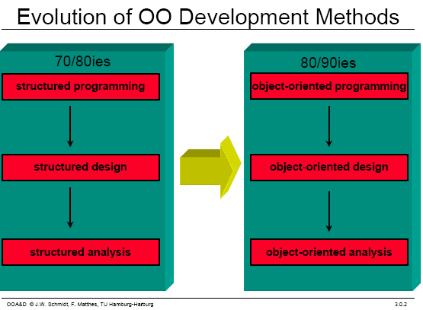
Software development evolution
Chapter 1: Why do we Model things
M. Mahmudul Hasan
S.6
MMH

Slide 7
UML
Chapter 1: Why do we Model things
M. Mahmudul Hasan
S.7
MMH
Unified Modeling Language
UML is a standardized general-purpose modeling language in the field of software engineering. The standard is managed, and was created by, the Object Management Group (OMG) (http://www.omg.org/)
UML website: http://www.uml.org
Why do you use UML?
Standardized graphical notation for Specifying, Visualizing, Constructing, and Documenting software systems
Increase understanding/communication of product to customers and developers
Support for UML in many software packages today (e.g., UMLet, Rational Rose, ArgoUML, etc.)

Slide 8

Building blocks of uml
Chapter 1: Why do we Model things
M. Mahmudul Hasan
S.8
MMH
The vocabulary of the UML include three kinds of building blocks:
  Things - abstractions that are primary concern in a model (John, Jesmin, Josheph, Jessy)
  Relationships - tie these things together (Father, Mother, Daughter, Son)
  Diagrams - group collections of things (Happy Family)

Slide 9
Things in uml
Chapter 1: Why do we Model things
M. Mahmudul Hasan
S.9
MMH
  Structural things
    nouns/static parts of UML models (irrespective of time)
Behavioral things
  verbs/dynamic parts of UML models
Grouping things
  organizational parts of UML models
Annotation things
  explanatory parts of UML models

Slide 10
Structural things
Chapter 1: Why do we Model things
M. Mahmudul Hasan
S.10
MMH
Structural things are the nouns of the UML model. These are the mostly static parts of a model, representing elements that are either conceptual or physical. There are seven kinds of structural things.
1. A Class
A class can be defined as a template/blueprint that describes the behaviors/states that object of its type support.
Description of set of objects that share the same attributes, operations, relationships and semantics
Student
Name ID CGPA DOB
Study ( ) Play ( ) Eating ( )

Slide 11
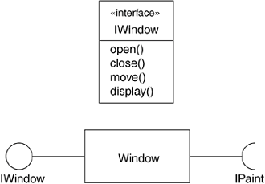
Structural things
Chapter 1: Why do we Model things
M. Mahmudul Hasan
S.11
MMH
2. An interface
Is a collection of operations that specify a
service of a class or component. An interface therefore describes the externally visible
behavior of that element.
You cannot instantiate an interface.
Therefore, interface does not contain any constructors.
An interface is not extended by a class;
it is implemented by a class (unchanged in implementation).
An interface can extend multiple interfaces.
Interface

Slide 12

Structural things
Chapter 1: Why do we Model things
M. Mahmudul Hasan
S.12
MMH
  3. A collaboration: A collection of UML building blocks
  (classes, interfaces, relationships) that work together to
  provide some functionality within the system. (e.g.,
  Interoperability, block chain technology to conned
  external system in providing one-stop e-services
  4. A Use case is a description of set of sequence of actions that a system performs that yields an observable result of value to a particular actor.
Registration
Course

Slide 13
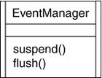
Structural things
Chapter 1: Why do we Model things
M. Mahmudul Hasan
S.13
MMH
5. An active class
is a class whose objects (known active object) own one or more processes or threads and therefore can initiate control activity (modify variables, change program behavior, and so on).
Active object initiate and control the flow of activity, while passive object wait for another object to call them generally for store data and serve other classes.
Graphically, an active class is rendered as a class with double lines on the left and right

Slide 14
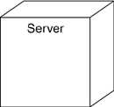
Structural things
Chapter 1: Why do we Model things
M. Mahmudul Hasan
S.14
MMH
6. A Component is a packaging of classes, interfaces, and collaboration. Total program is divided into various parts or module.
7. A Node: Computational resources that exists at run time, typically h/w resources
e.g., memory, processor, etc.
Course.cpp

Slide 15
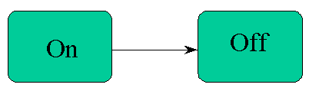
behavioral things
Chapter 1: Why do we Model things
M. Mahmudul Hasan
S.15
MMH
These are the verbs of a model.
Dynamic parts of UML models.
Representing behavior over time and space.
There are two kinds of behavioral things
1. Interaction: A set of object exchanging messages to accomplish a specific purpose
2. A state machine: specifies the sequence of states that an object or an interaction goes through during its lifetime in response to events.
Msg: Vacation
Study
Vacation
Msg: Study

Slide 16
grouping things
Chapter 1: Why do we Model things
M. Mahmudul Hasan
S.16
MMH
The organizational parts of UML models. These are the boxes into which a model can be decomposed. There is one primary kind of grouping thing, namely, packages.
Organizing elements (structural/behavioral) into groups.
Purely conceptual. only exists at development time. And can be nested.
Variations of packages are: Frameworks, models, & subsystems.
University Administration
Course Manager
Student Admission
-Student
+Department

Slide 17
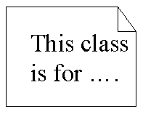

Annotational things
Chapter 1: Why do we Model things
M. Mahmudul Hasan
S.17
MMH
Annotational things are the explanatory parts of UML models.
These are the comments you may apply to describe, illuminate, and remark about any element in a model.
There is one primary kind of Annotational thing, called a note.

Slide 18
Relationships in uml
Chapter 1: Why do we Model things
M. Mahmudul Hasan
S.18
MMH
There are four kinds of relationships in the UML
  Association
  Generalization
  Realization
  Dependency
Association: is a structural relationship that describes a set of links. A link is a connection between objects.
Student
attends
University

Slide 19
Relationships in uml
Chapter 1: Why do we Model things
M. Mahmudul Hasan
S.19
MMH
Generalization: can be defined as a relationship which connects a specialized element with a generalized element. It basically describes inheritance (IS-A) relationship in the world of objects.
Student
registration
parent
child
under-graduate
registration
graduate
registration

Slide 20


Relationships in uml
Chapter 1: Why do we Model things
M. Mahmudul Hasan
S.20
MMH
Realization: denotes the implementation (interface) of the functionality defined in one class by another class.
Dependency: is a relationship between two things in which change in one element also affects the other one.
class A3 implements B3
class A depends on class B

Slide 21
Diagrams in uml
Chapter 1: Why do we Model things
M. Mahmudul Hasan
S.21
MMH
A diagram is the graphical presentation of a set of elements, most often rendered as a connected graph of vertices (things) and arcs (relationships). The UML includes nine such diagrams.
Structural Diagrams
Represent the static aspects of a system.
  Class Diagram
  Object Diagram
  Component Diagram
  Deployment Diagram
Behavioral Diagrams
Represent the dynamic aspects of a system.
  Use case Diagram
  Sequence Diagram (Interaction)
  Collaboration Diagram
  Statechart Diagram
  Activity Diagram

Slide 22
Diagrams in uml
Chapter 1: Why do we Model things
M. Mahmudul Hasan
S.22
MMH
Class diagram shows a set of classes, interfaces, and collaborations and their relationships. Class diagrams address the static design view of a system. Class diagram that includes active classes address the static process view of a system.
Object diagram shows a set of objects and their relationships. Object diagrams represent static snapshots on instances of the things found in class diagrams. These designs address the static design or process view of a system from the perspective of real or prototypical cases.
Component diagram shows an encapsulated class and its interfaces, ports, and internal structure consisting of nested components and connectors. Component diagrams address the static design implementation view of a system.
Use case diagram shows a set of use cases and actors and their relationships. Use case diagrams address the static use case view of a system.

Slide 23
Diagrams in uml
Chapter 1: Why do we Model things
M. Mahmudul Hasan
S.23
MMH
Both sequence diagrams and communication diagrams are kinds of interaction diagrams. An interaction diagram shows an interaction, consisting of a set of objects or roles, including the messages that may be dispatched among them. Interaction diagrams address the dynamic view of a system.
A sequence diagram is an interaction diagram that emphasizes the time-ordering of
messages; a communication diagram is an interaction diagram that emphasizes the
structural organization of the objects or roles that send and receive messages.
State diagram shows a state machine, consisting of states, transitions, events, and activities. A state diagrams shows the dynamic view of an object.

Slide 24
Diagrams in uml
Chapter 1: Why do we Model things
M. Mahmudul Hasan
S.24
MMH
Activity diagram shows the structure of a process or other computation as the flow of control and data from step to step within the computation. Activity diagrams address the dynamic view of a system. They are especially important in modeling the function of a system and emphasize the flow of control among objects.
Deployment diagram shows the configuration of run-time processing nodes and the components that live on them. Deployment diagrams address the static deployment view of an architecture (networking). A node typically hosts one or more artifacts.
Artifact diagram shows the physical constituents of a system on the computer. Artifacts include files, databases, and similar physical collections of bits. Artifacts are often used in conjunction with deployment diagrams.

Slide 25
Diagrams in uml
Chapter 1: Why do we Model things
M. Mahmudul Hasan
S.25
MMH
Package diagram shows the decomposition of the model itself into organization units and their dependencies (package contains a set of diagrams and their dependency grouping).
Timing diagram is an interaction diagram that shows actual times across different objects or roles, as opposed to just relative sequences of messages.
Interaction overview diagram is a hybrid of an activity diagram and a sequence diagram.

Slide 26
Architecture of OO Software System
Chapter 1: Why do we Model things
M. Mahmudul Hasan
S.26
MMH
To understand the architecture of object oriented software system, one needs several complementary and interlocking views:
  A use case view (exposing the requirements of the system),
  A design view (capturing the vocabulary of the problem space and the solution space),
  A process view (modelling the distribution of the system’s processes and threads),
  An implementation view (addressing the physical realization of the system),
  A deployment view (focusing on system engineering view).
Each of these views may have structural, as well as behavioural, aspects. Together these views represent the blueprints of Object Oriented Software System.

Slide 27
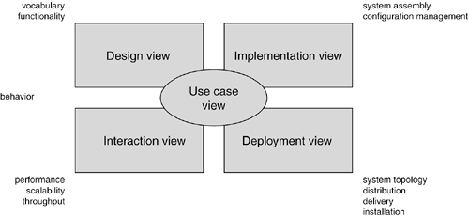
System architecture modeling
Chapter 1: Why do we Model things
M. Mahmudul Hasan
S.27
MMH

Slide 28
Uml architecture
Chapter 1: Why do we Model things
M. Mahmudul Hasan
S.28
MMH
Visualizing, specifying, constructing and documenting a software intensive system demands that the system be viewed from a number of perspectives (e.g., ATM system development design in several diagram drawing perspective).
Different stakeholders- end users, analysts, developers, system integrators, testers, technical writers and project managers- each bring different agenda to a project, and each looks at that system in different ways at different times over the project’s life.
1. The use case view of a system encompasses the use cases that describe the behavior of the system as seen by its end users, analysts, and testers. With the UML, the static aspects of this view are captured in use case diagrams; the dynamic aspects of this view are captured in interaction diagrams, state diagrams, and activity diagrams.

Slide 29
Uml architecture
Chapter 1: Why do we Model things
M. Mahmudul Hasan
S.29
MMH
2. The design view of a system encompasses the classes, interfaces, and collaborations that form the vocabulary of the problem and its solution. This view primarily supports the functional requirements of the system, meaning the services that the system should provide to its end users. With the UML, the static aspects of this view are captured in class diagrams and object diagrams; the dynamic aspects of this view are captured in interaction diagrams, state diagrams, and activity diagrams.
3. The interaction view of a system shows the flow of control among its various parts, including possible concurrency and synchronization mechanisms. This view primarily addresses the performance, scalability, and throughput of the system. With the UML, the static and dynamic aspects of this view are captured in the same kinds of diagrams as for the design view, but with a focus on the active classes that control the system and the messages that flow between them.

Slide 30
Uml architecture
Chapter 1: Why do we Model things
M. Mahmudul Hasan
S.30
MMH
The implementation view of a system encompasses the artifacts that are used to assemble and release the physical system. This view primarily addresses the configuration management of the system's releases, made up of somewhat independent files that can be assembled in various ways to produce a running system. It is also concerned with the mapping from logical classes and components to physical artifacts. With the UML, the static aspects of this view are captured in artifact diagrams; the dynamic aspects of this view are captured in interaction diagrams, state diagrams, and activity diagrams.
5. The deployment view of a system encompasses the nodes that form the system's hardware topology on which the system executes. This view primarily addresses the distribution, delivery, and installation of the parts that make up the physical system. With the UML, the static aspects of this view are captured in deployment diagrams; the dynamic aspects of this view are captured in interaction diagrams, state diagrams, and activity diagrams.

Slide 31
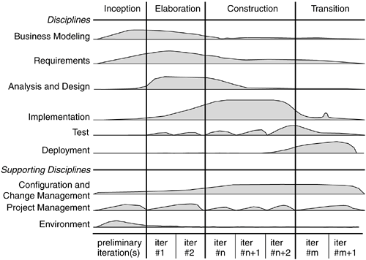
SDLC – Rational Unified Model (RUP)
Chapter 1: Why do we Model things
M. Mahmudul Hasan
S.31
MMH

Slide 32
SDLC – Rational Unified Model (RUP)
Chapter 1: Why do we Model things
M. Mahmudul Hasan
S.32
MMH
Inception is the first phase of the process, when the seed idea for the development is brought up to the point of being at least internally sufficiently well-founded to warrant entering into the elaboration phase.
Elaboration is the second phase of the process, when the product requirements and architecture are defined. In this phase, the requirements are articulated, prioritized, and baselined. A system's requirements may range from general vision statements to precise evaluation criteria, each specifying particular functional or nonfunctional behavior and each providing a basis for testing.
Construction is the third phase of the process, when the software is brought from an executable architectural baseline to being ready to be transitioned to the user community. Here also, the system's requirements and especially its evaluation criteria are constantly reexamined against the business needs of the project, and resources are allocated as appropriate to actively attack risks to the project.

Slide 33
SDLC – Rational Unified Process (RUP)
Chapter 1: Why do we Model things
M. Mahmudul Hasan
S.33
MMH
Transition is the fourth phase of the process, when the software is delivered to the user community. Rarely does the software development process end here, for even during this phase, the system is continuously improved, bugs are eliminated, and features that didn't make an earlier release are added.
Iteration is a distinct set of work tasks, with a baselined plan and evaluation criteria that results in an executable system that can be run, tested, and evaluated.

Slide 34
references
Chapter 1: Why do we Model things
M. Mahmudul Hasan
S.34
MMH
Booch, G., Rumbaugh, J. & Jacobson, I. (2005). The unified modeling language user guide. Pearson Education India.

